Slide 1
SOLID principles
By Kamil Hadas

Slide 2

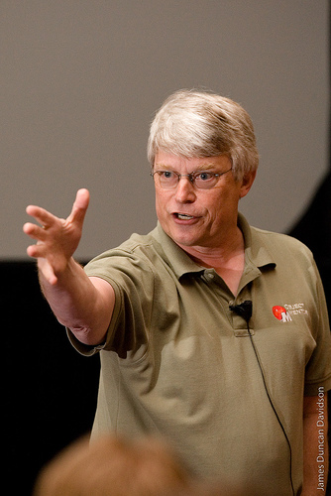
Robert “Uncle Bob” Martin

Slide 3
S.O.L.I.D.
Single Responsibility Principle
Open-Close Principle
Liskov Substitution Principle
Interface Segregation Principle
Dependency Inversion Principle

Slide 4
Why do we need code to be “clean”?
Easy to extend
Easy to understand
Split complexity into small modules
Cheaper to maintain
Other Developers simply understand your code when you using common patterns.

Slide 5

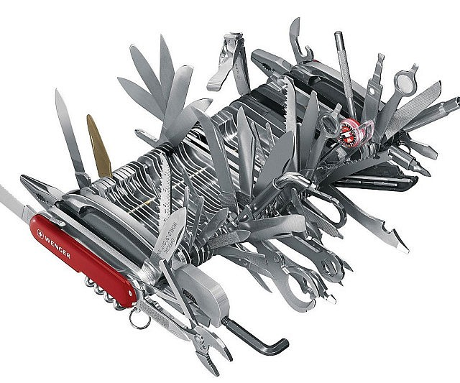
Single Responsibility Principle
A class should have one and only one reason to change.

Slide 6
Time for Code example ☺

Slide 7
Open-Close Principle
Objects or entities should be open for extension, but closed for modification.

Slide 8


Slide 9
Liskov Substitution Principle
Let q(x) be a property provable about objects of x of type T. Then q(y) should be provable for objects y of type S where S is a subtype of T.

Slide 10


Slide 11
End of part one…
Recommended books:
“Clean Code”
“Agile software development”

Slide 12
Q&A

Slide 13
Interface Segregation
A client should never be forced to implement an interface that it doesn’t use or clients shouldn’t be forced to depend on methods they do not use.

Slide 14
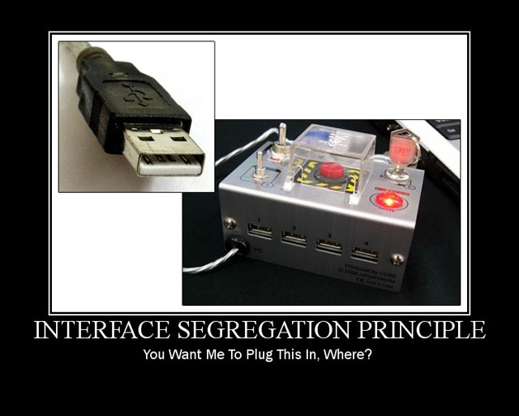

Slide 15
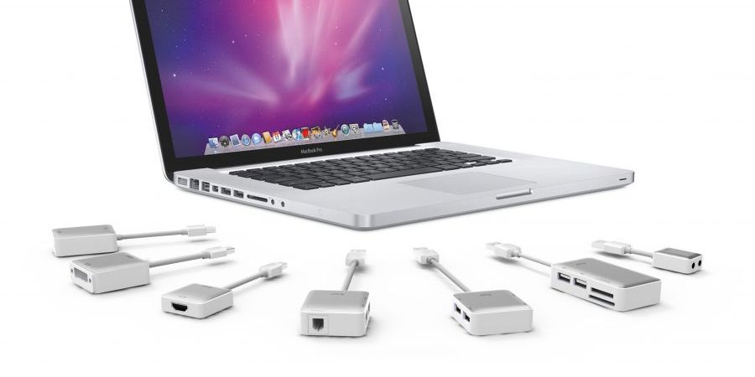

Slide 16
Dependency Inversion
Entities must depend on abstractions not on concretions. It states that the high level module must not depend on the low level module, but they should depend on abstractions.

Slide 17
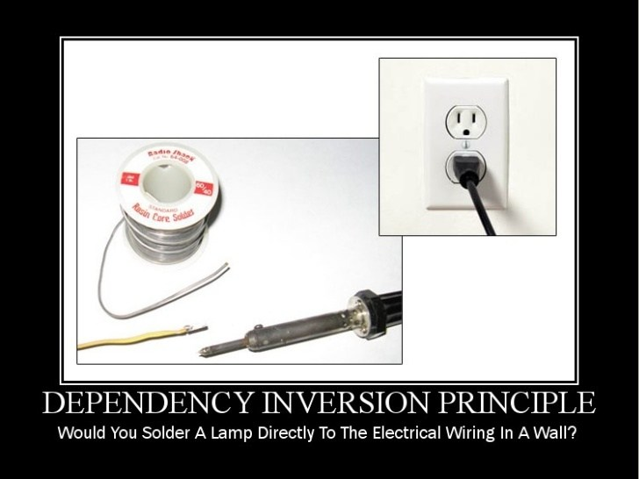

Slide 18
JavaScript ES6 features*
Classes
Subclasses
let+ const
Modules
Module loader
More “Object oriented” than before
And Objective languages more functional than before
*or ES5 I mean more the direction where language evolve than concrete version

Slide 19
Working examples
And Q&A or discussion after ☺
Link to .NET/Umbraco example
https://github.com/Haas360/webdotnet
Features of ES6:
https://github.com/lukehoban/es6features
http://es6-features.org/#Constants

